Slide 1
Waterfall SDLC
Main page
login ( gmail , facebook, website)
signup/register
forgot password
unsubscribe
Landing page
browsing - product
cart management - add/remove
check out
Promo and offers
payment
guest check out payment
Credit, debit
Crypto , installments
Paypal
Through Phone 1800 (Customer Care)
Reviews
Notifications
email
mail
phone
text
Analysis
Are the technologies available
Are there developers with these skills
2 Months
System design : Choose Platform, language, database
2 Months
2 Months
High level design : Choose website framework, html technologies, web services etc
2 Months
Low level design : Design java programs, html etc
2 Months
4 Months
Development : assign task to developers
Waterfall model : This legacy/traditional software development
approach requires all the details and software specifications to be documented/captured upfront. Due to lengthy documentation ,development and testing phase the final product usually is delivered after a very long period of time. The main issues with this approach
Longer delivery time.
Final product cannot be validated/seen until the end of product
Unable to adapt to requirement changes.
testing: test website as per requirements
Deployment: launch website on internet
12 Months to Launch

Slide 2
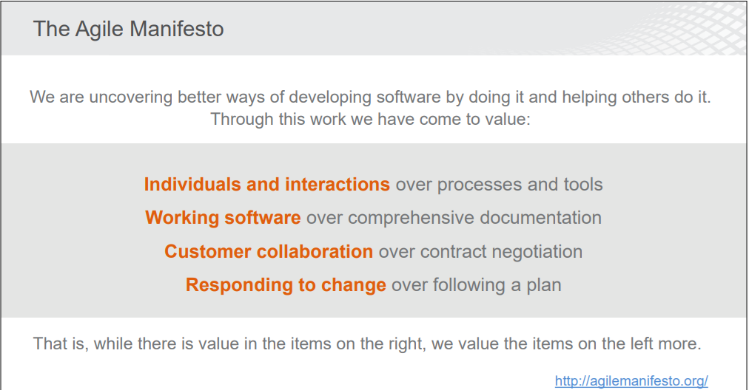
Agile Software Development Methodology

Slide 3
Scrum Fraework
Scrum is an agile software development methodology. This methodology adapts multiple iteration of development. It allows us to release product in mutiple phases there by allowing us to adapt to new changes in requirement, visualize the product in short time, shorter release period, engage all stake holders including client at every stage and engage quiet often. This creates dynamic team with maximum collaboration.
Scrum Terms
Sprint : Agile development is iterative model programming. Single iteration can be considered as sprint. These release are usually every 2-3 weeks.
Epic : An epic is collection of stories
Stories : story represents an single feature in user requirements.
Task : task is usually part of a single story and represent single task.
Bug : on test failure a bug can be created on story/task.
Issues : Epic/ story/ bug are created as issue in sprint.
Stake holders : team member involved in product such as (tester, developer etc)
Scrum master : this stake holder acts like moderator who helps in conducting scrum meeting, update/assign tasks, provide project details etc.

Slide 4
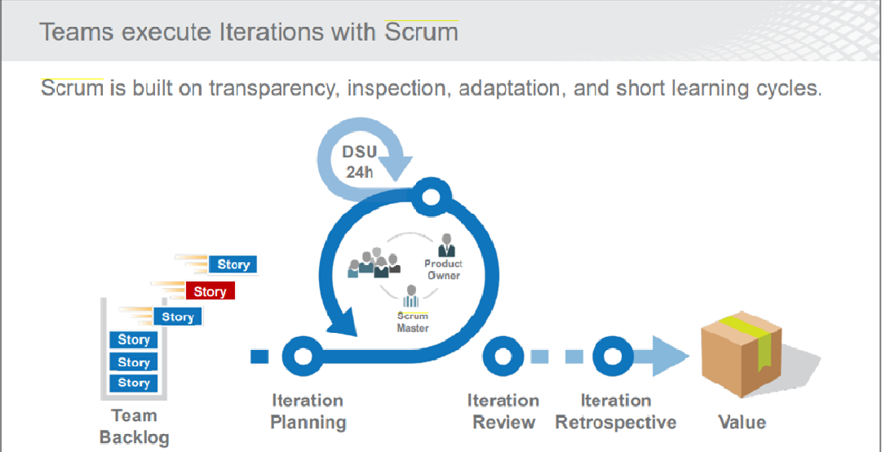

Slide 5
Sprint SDLC (Iteration model)
Landing page
browsing - product
cart management - add/remove
check out
payment
Pay by phone
Main page
login ( gmail , facebook)
payment
paypal
Main page
Login ( website)
signup/register
forgot password
Unsubscribe
1-2 Months
2-4 weeks
2-4 weeks
User Story
Shopping Epic
Promo and offers
Reviews
Notifications
phone
text
Notifications
email
mail
2-4 weeks
2-4 weeks
2-4 weeks
Promos Epic
payment
Installments, debit
payment
Crypto
payment
Credit
2-4 weeks
2-4 weeks
2-4 weeks
Sprint
Payment Epic

Slide 6
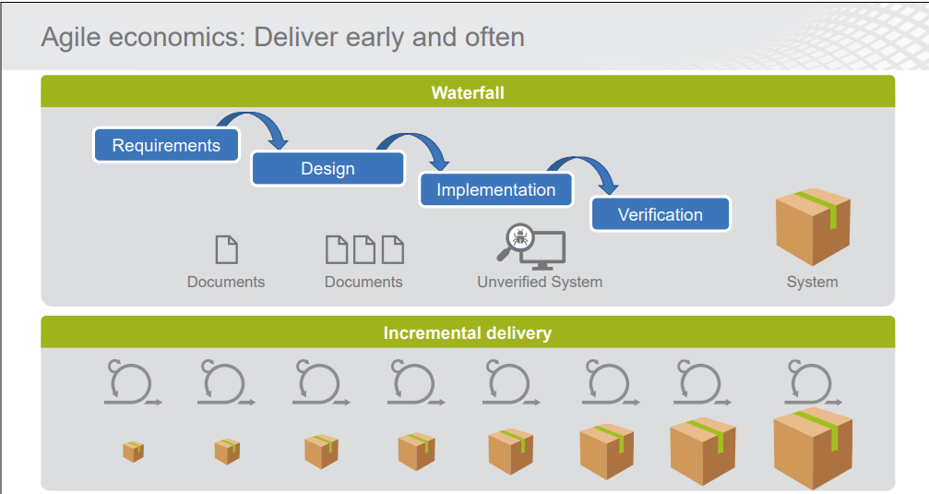

Slide 7
Jira
Jira : This web portal allows developers to track project update and follow issues.
Jira Account and project setup ( study/training purpose )
https://www.atlassian.com/ -> try free -> Jira software (try free)
Jira software & documentation (Jira & Confluence) -> try free
Enter all information and create account -> Check email and click verify account
Click skip on all options -> choose template “scrum” -> create project. -> backlog -> create sprint
Permissions
Click Project settings -> scroll left -> permission ->click actions (right top)
Edit permission->Administer project (Edit) -> show more -> Project lead -> grant
Create Epic
Click + left panel -> issue type epic -> enter epic name & summary & select sprint
Create Story/task/bugs
Click + left panel -> issue type story/task/bugs -> enter summary / description -> select epic link and sprint if needed -> click create
Create status
Click *** -> board setting -> columns -> delete in-progres -> add column -> analysis -> add -> add column -> developmment -> add -> add column -> testing -> add
Start sprint
Click backlog -> start sprint -> provide duration , start & end date -> start
Update task
Click active sprint -> Drag and drop tasks to desired column

Slide 8
Test Driven Development
Developers are usually known to focus more on requirement and making the system work first and test later. This results in minimal testing and unstable/bug ridden system. By reversing the process TDD focuses more on testing ,there by ensuring stable systems with less issues.
Test Driven Development : Based on requirement gathering and design, test cases are developed first. This process follows test first approach since code development is done after the test cases are written. Developer has to code and recode during the refactor process until the test pass. Once the test pass developer can then move on to next requirement/feature.
Below steps are part of TDD process.
Requirement & design
Write Test cases
Code development
PASS
FAIL
Test
Code Refactor

Slide 9
Github
Git Repository : this is a Navigation panel that allows to browse through the files and provides options to GIT actions such as (push, pull, fetch, etc)
Git Staging : This section shows all the files that have been changed on the local and are due to be sent to remote repository (Github cloud). We can provide comments and commit the new changes from here.
Local Repository : local copy of the code , this is the private workspace where developers can make code changes.
Remote Repository/Upstream : centralized code repository (server or cloud) where all developers synchronize / upload / download code from.
Branches : different branches allows us to baseline different versions , different features.
Tags : tags are used to mark milestone in the application. Usually a stable code base or new feature or new code launch.
Pull : right click on project in git repository and select pull. This option allows us to download the latest code from centralized github cloud.
Push : right click on project in git repository and select push to upstream. This option allows us to upload the local updated code to centralized github cloud.
Fetch : right click on project in git repository and select fetch from upstream. while performing push operation if there were other changes uploaded/commited by other developers , push operation will be rejected. Fetch allows us to download these changes in local for resolving conflict or merge or rebase.
Merge : right click on project in git repository and select Merge. Merge option allows us to keep track of all commits and historical changes committed by different developers in single timeline. Use if there are lot of developers working and committing on main branch and if you would like to keep track of all historical changes and committs.
Rebase : right click on project in git repository and select Rebase. Rebase realigns the original branch to new commits. This allows us to realigns, edit commits. This integration pretends as if the changes were done by everyone sequentially. Use when your code changes are more active on the GIT and you would like to keep clean but not accurate history of commits.

